Slide 1
Programming Language
Shahriar’s Analytical Academy

Slide 2

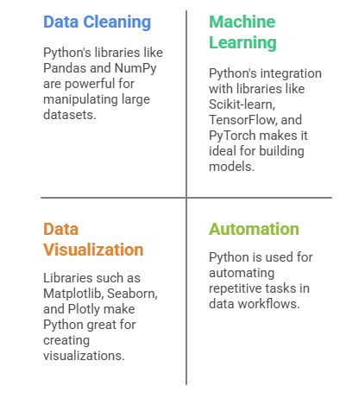
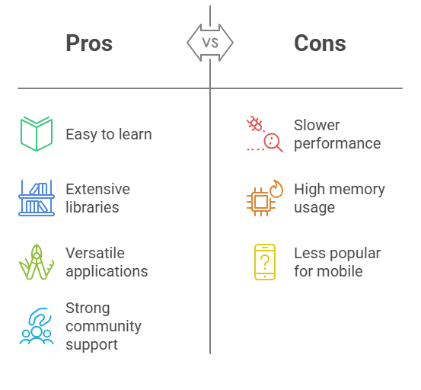
Python
Python is a high-level, interpreted programming language known for its readability and ease of use. It is widely used in data science, machine learning, web development, and automation. Python supports multiple programming paradigms including object-oriented, imperative, and functional programming.
Notes:
Python is a popular, high-level programming language known for its simple and readable syntax. It is an interpreted language, which means that code can be executed directly without a separate compilation step. Python is famous for its versatility and is used across many fields, such as web development, data analysis, machine learning, and automation. Its ease of use makes it particularly appealing to beginners and experts alike.
One of the defining features of Python is its support for multiple programming paradigms, including object-oriented, imperative, and functional programming. This allows programmers to write code in various styles depending on the project requirements. Python’s broad scope and simplicity make it one of the most popular programming languages globally.
When to Use Python?
Python excels in several areas:
Data Cleaning & Preprocessing: Libraries like Pandas and NumPy are robust tools for cleaning, manipulating, and preparing large datasets for analysis. Python simplifies tasks like filtering, grouping, and transforming data.
Machine Learning: Python’s integration with powerful machine learning libraries such as Scikit-learn, TensorFlow, and PyTorch makes it an excellent choice for building machine learning models, from simple linear regressions to complex deep learning models.
Data Visualization: With libraries like Matplotlib, Seaborn, and Plotly, Python provides an easy way to create meaningful data visualizations to communicate insights effectively.
Automation & Scripting: Python is often used to automate repetitive tasks such as file management, data extraction, and workflow automation, saving time and improving efficiency.
Web Scraping: Python tools like BeautifulSoup and Scrapy make it a popular language for extracting data from websites, enabling users to collect and process web data.
Advantages of Python
Ease of Learning and Readability: Python has a simple syntax, which makes it easy for beginners to understand and write code. Its readability improves the maintainability of code, making it easier for teams to collaborate.
Large Ecosystem of Libraries: Python boasts a vast array of libraries for a variety of tasks, including data analysis (Pandas, NumPy), machine learning (TensorFlow, PyTorch), and visualization (Matplotlib, Seaborn), making it a one-stop-shop for most projects.
Versatile: Python can be used in many areas such as web development (Django, Flask), scientific computing, artificial intelligence, and more, which makes it a versatile tool in the programming world.
Community Support: Python has an extensive community of users, which means access to plenty of online resources, tutorials, and forums. This makes troubleshooting easier and keeps the language continuously evolving.
Disadvantages of Python
Speed: Python tends to be slower than compiled languages like C or Java because it’s an interpreted language. This may not be ideal for time-sensitive tasks or applications that require high performance, such as processing large datasets in real-time.
Memory Consumption: Python’s dynamic nature leads to higher memory usage compared to lower-level languages like C or C++. This can be a limiting factor when working with memory-constrained systems.
Mobile Development: While Python is great for many applications, it is not commonly used for mobile app development. Other languages like Swift (for iOS) or Kotlin (for Android) are generally preferred for mobile platforms.

Slide 3

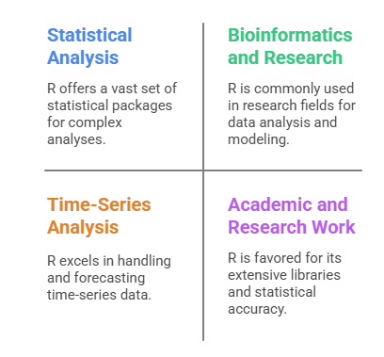
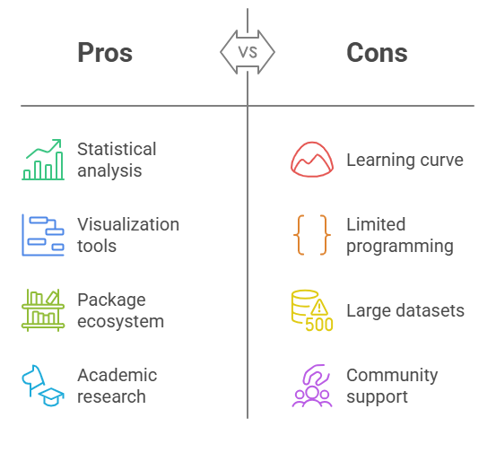
R – programming
R is a programming language is widely used by statisticians, data analysts, and researchers for data analysis, statistical modeling, and data visualization. R provides a comprehensive set of statistical and graphical methods, including linear and nonlinear modeling, classical statistical tests, time-series analysis, and clustering.
Notes:
R is a specialized programming language and software environment designed for statistical computing and data analysis. It is widely used by statisticians, data analysts, and researchers for analyzing data, performing statistical modeling, and visualizing data. R’s strength lies in its ability to handle complex statistical tasks and produce high-quality visualizations, making it an essential tool for anyone working in research-heavy fields.
R is unique in that it offers a vast array of statistical and graphical methods, from linear modeling to time-series analysis. It is open-source and free, with a large number of packages available to extend its functionality.
When to Use R?
R is particularly effective in situations where detailed statistical analysis and data visualization are required:
Statistical Analysis: R’s extensive set of functions for statistical analysis makes it the go-to tool for performing tasks like linear regression, hypothesis testing, and multivariate analysis.
Data Visualization: R is known for its advanced data visualization capabilities, particularly through packages like ggplot2. These tools allow users to create highly customizable and aesthetically pleasing visualizations to interpret data clearly.
Bioinformatics and Research: R is widely used in fields like bioinformatics, epidemiology, and social sciences. It offers specialized libraries for tasks like gene expression analysis, survival analysis, and epidemiological modeling.
Time-Series Analysis: For forecasting and analyzing time-series data, R’s packages like forecast are specifically tailored to handle such tasks, making it the preferred choice for analyzing time-dependent data.
Academic and Research Work: Due to its deep statistical capabilities and large number of academic references, R is a favorite tool among researchers and academics.
Advantages of R
Superior for Statistical Analysis: R is specifically built for statistical computing. Its broad array of functions and packages makes it one of the best languages for performing complex statistical analysis.
Rich Visualization Tools: With ggplot2 and other packages, R excels in creating high-quality, customizable data visualizations that help users present their findings effectively.
Extensive Package Ecosystem: R has a large number of specialized packages for various types of statistical and data analysis tasks, which enables users to perform everything from simple analysis to advanced machine learning.
Great for Academic Research: R is favored by academic researchers for its open-source nature, extensiveness, and focus on statistical accuracy, making it ideal for research-intensive applications.
Disadvantages of R
Learning Curve: While R is powerful, its unique syntax and approach to statistical analysis can be challenging for beginners. The learning curve is steeper than that of Python, particularly for those new to programming.
Limited General-Purpose Programming: Unlike Python, R is not designed for general-purpose programming tasks such as web development, software development, or automation. It is specialized for statistical work and is not as versatile in other domains.
Less Efficient with Large Datasets: R tends to be slower and less memory-efficient than Python, especially when working with large datasets or performing high-performance tasks. Python and other languages tend to perform better in such cases.
Less Community Support: While R has an active community, it’s not as large as Python’s. This can sometimes make it harder to find support for non-statistical tasks or more general programming problems.

Slide 4
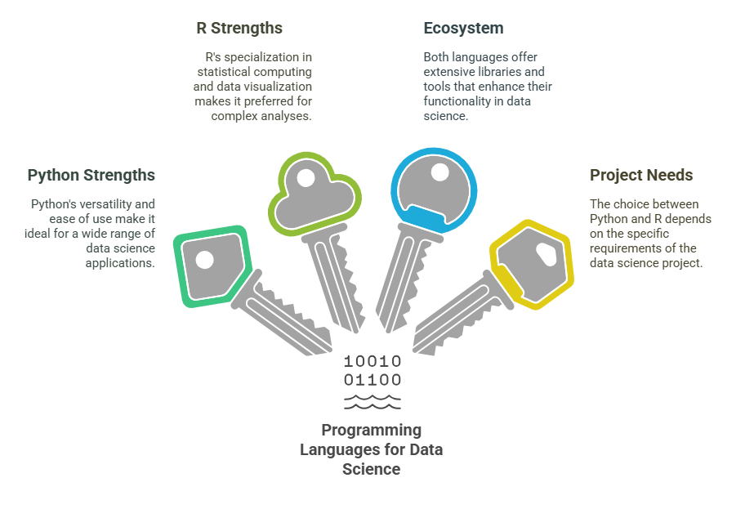
4 Key Learning Points of this Lesson
Notes:
Python is a versatile, easy-to-learn programming language ideal for tasks like data manipulation, machine learning, and automation. It has a rich ecosystem of libraries that support various fields, including web scraping, data science, and general-purpose programming.
R is specifically tailored for statistical computing and is the preferred choice for conducting complex statistical analysis and creating detailed visualizations. Its ecosystem of packages makes it a powerful tool for research, bioinformatics, and time-series analysis.
Python offers a broad range of uses beyond data science, such as web development and automation, making it a more general-purpose language. Its large community and ease of learning make it a popular choice for beginners and professionals.
R shines in specialized tasks related to statistics and data visualization, and is highly regarded in academic and research circles. While it may not be as versatile as Python, it excels in its niche, especially for those focused on data analysis and research-heavy applications.

Slide 5
Thank You!
Shahriar’s Analytical Academy

